Slide 1
Sexchatology and sex-positive christianity
Susannah Cornwall, Senior Lecturer in Constructive Theologies, University of Exeter, UK
s.m.cornwall@exeter.ac.uk

Slide 2
What do you think of when you think about Christianity and sex?

Slide 3
What do you think of when you think about Christianity and sex?
Repression
Shame
Homophobia
Sexism
Sexual abuse
Gender violence
Alienation from the body
Original sin

Slide 4
Sexuality and incarnation
“Christianity is the religion of the Incarnation. Christians’ core belief is that God entered the human world of bodies and senses in the person of Jesus of Nazareth ... As the religion of the Incarnation, Christianity is about the construction of Christian bodies and, according to Christian belief, the perfection of Christian bodies in the resurrection of the flesh.” (Miles 2005: 1-2)

Slide 5
Sexuality and incarnation
But what does all that mean for the “flesh” and its desires here and now?

Slide 6
Early Christianity
Heritage from Hebrew (pre-Jewish) tradition: focus on goodness of material creation; focus on sex and fertility as signs of divine blessing; some fear of chaos and boundary-crossing.
Heritage from Greco-Roman culture: focus on the spiritual and intellectual; focus on power and hierarchy; some sense that bodies were messy, inconvenient, and to be escaped.

Slide 7
Early Christianity
Particular influence from Stoic and Gnostic philosophy: sexual passion was disruptive and irrational; the body was “lower” than the soul; virginity represented wholeness and lack of corruption.
Sex led to birth which led to death – souls being tied to failing bodies rather than being able to float free of them.

Slide 8
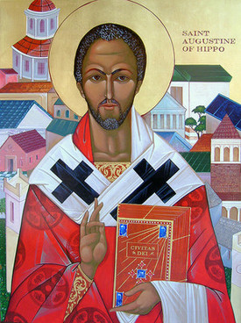
Early Christianity
In Augustine of Hippo we see traces of all these influences. He was troubled by the passion and “irrationally” of his own sexual desires, but he also said bodies and matter were gifts from God, not to be denied or seen as negative.

Slide 9
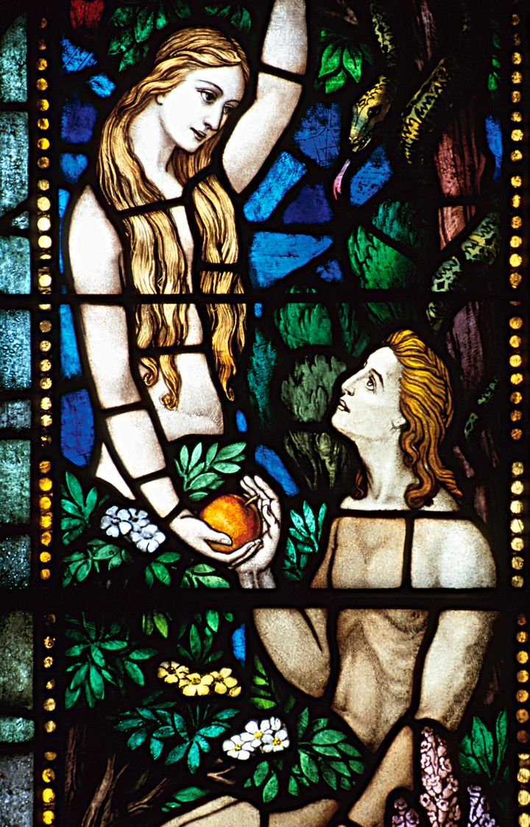
Christianity and sexuality
Christianity has been dealing with this complex legacy ever since.
Genesis 1:28 – “Be fruitful and multiply”
This verse has been used to oppose same-sex relationships (which are not fertile in the way heterosexual ones are), but can also be seen as an affirmation of the goodness of bodies, sex and fertility.

Slide 10
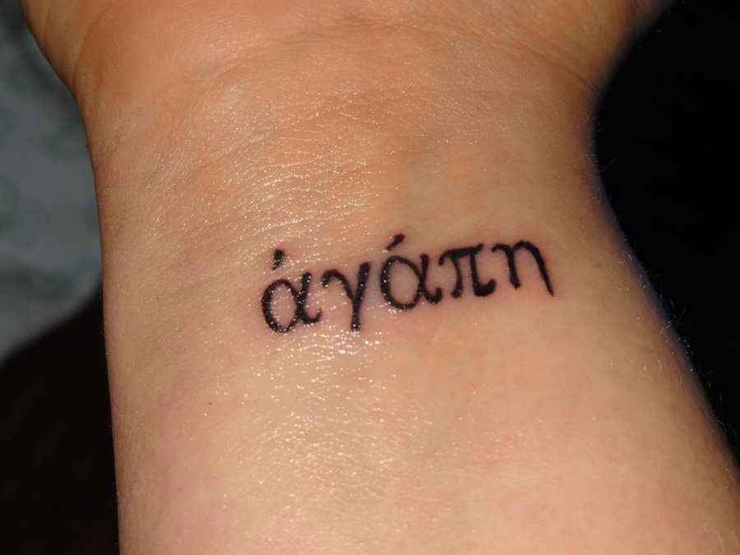
Greek words for love
Philia – love between friends or siblings
Storge – affectionate love of a parent for a child
Agape – deep, self-sacrificial love
Eros – passionate, romantic and/or sexual love

Slide 11
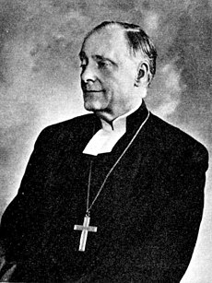
Anders Nygren: eros and agape in tension
“Eros and Agape belong originally to two entirely separate spiritual worlds” (Nygren 1953: 31)
Agape as selfless divine love; eros as selfish, vulgar, and easily corruptible.

Slide 12
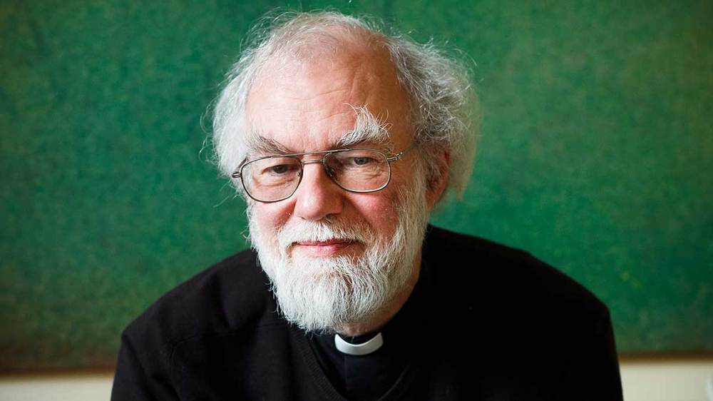
Rowan Williams: eros and agape in union
“The whole story of creation, incarnation, and our incorporation into the fellowship of Christ’s body tells us that God desires us, as if we were God, as if we were that unconditional response to God’s giving that God’s self makes in the life of the Trinity. We are created so that we may be caught up in this, so that we may grow into the wholehearted love of God by learning that God loves us as God loves God.” (Williams 2002: 311-12)

Slide 13
Margaret Farley: eros and beauty
Eros, a desire for another, prompts us to look beyond ourselves.
But it is not just a means to an end: “Sexual romantic love and desire, even when they are ultimately incorporated in a great love that affirms more than sexual union, need not discard sex or sexuality along the way.” (Farley 2006: 173)

Slide 14
Julian of Norwich: eros and creativity
Used erotic imagery to describe divine-human relationships.
Understood eros as bringing together passions for beauty, peace, harmony.
Eros is a prompt for creating loving and just relationships.

Slide 15
Distinction between eros and lust
Lust is understood as a desire to possess, control, consume.
This is a distortion of free, consensual, just love.

Slide 16
The world now / the world to come
“Erotic intimacy can push the limits of our normal, enfleshed, bounded existence and let us experience the power of being both earthbound animals and skybound lovers.” (Jones 2010: 301)

Slide 17
The world now / the world to come
Eschatology: from Greek ta eschata, “the last things”
“Already and not yet”
The time between the times
“The last things are also the first things for Christians, the defining movements of their characters and lives” (Stuart 2004: 63).

Slide 18
The world now / the world to come
Discontinuity: end to violence, exploitation, oppression
Continuity: what of our present sexualities, genders, bodies will be “carried over” to the next world?
“Eschatological eros” means carrying over our bodily identities, memories and desires into the new creation (Kamitsuka 2010b: 263).

Slide 19
Sexchatology
All Christian thought about sexuality takes place in the context of a present and future hope for a new creation.
In this new creation sexuality has become fully and rightly integrated into human being: no longer a site of pain, tragedy, violence, jealousy, doubt, shame, self-loathing.
Inaugurated eschatology: these just and right patterns of sexuality understood as already possible via solidarity, justice and love in relationship.

Slide 20
Sexchatology
Sex in light of ends; sex in light of new beginnings. No condemnation to repeat old mistakes or dynamics.

Slide 21
Works cited
Ahlgren, Gillian T. W. (2005), “Julian of Norwich’s Theology of Eros”, Spiritus: A Journal of Christian Spirituality 5.1, 37-53
Cornwall, Susannah (2013), Theology and Sexuality, London: SCM Press
Jones, Serene (2010), “Afterword”, in Kamitsuka, Margaret D. (ed.), The Embrace of Eros: Bodies, Desires, and Sexuality in Christianity, Minneapolis, MN: Fortress Press, 297-302
Kamitsuka, Margaret (2010), “Sex in Heaven? Eschatological Eros and the Resurrection of the Body”, in Kamitsuka, Margaret D. (ed.), The Embrace of Eros: Bodies, Desires, and Sexuality in Christianity, Minneapolis, MN: Fortress Press, 261-276
Miles, Margaret (2005), The Word Made Flesh: A History of Christian Thought, Malden, MA: Blackwell
Nygren, Anders (1953), Agape and Eros, trans. Watson, Philip S., Philadelphia, PA: Westminster Press
Stuart, Elizabeth (2004), “Queering Death”, in Althaus-Reid, Marcella and Lisa Isherwood (eds.), The Sexual Theologian: Essays on Sex, God and Politics, London and New York: T&T Clark, 58-70
Williams, Rowan (2002), “The Body’s Grace”, in Rogers, Eugene F. (ed.) (2002a), Theology and Sexuality: Classic and Contemporary Readings, Oxford: Blackwell, 309-321

